Slide 1
Machine Learning
1 . The Machine Learning Landscape
What Machine Learning is, what problems it tries to solve, and the main categories and fundamental concepts of its systems

Slide 2
Wie ben ik?
Johan Decorte
Burgerlijk ingenieur computerwetenschappen (KUL ‘86)
25 jaar IT-carrière bij Siemens, Barco, Attentia, Agfa
Momenteel:
Docent/onderzoeker (big) data en AI bij HOGENT/CADS
Trainer/consultant (big) data en AI
Gepassioneerd door (big) data en de strategische meerwaarde van IT voor organisaties

Slide 3

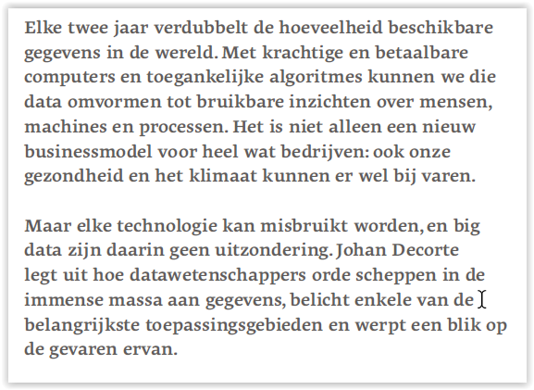
Auteur van het boek:

Slide 4
Cursusmateriaal
https://github.com/jdecorte/ML_DRUM/blob/main/000-index.ipynb

Slide 5
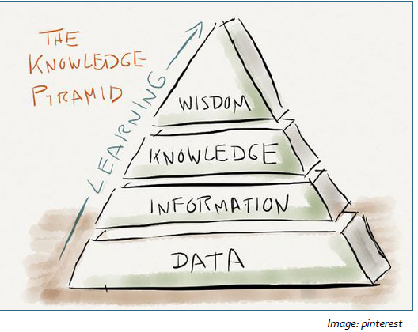

Slide 6
Business Intelligence (BI): definition
Business Intelligence(BI) comprises the set of strategies, processes, applications, data, technologies and technical architectures which are used by enterprises to support the collection, data analysis, presentation and dissemination of business information.
BI technologies provide historical, current and predictive views of business operations.
Common functions of business intelligence technologies include reporting, online analytical processing, analytics, data mining, process mining, complex event processing, business performance management, benchmarking, text mining, predictive analytics and prescriptive analytics.
Source: wikipedia
Notes:
BI is een overkoepelende term waarmee applicaties, infrastructuur en hulpmiddelen en aangeraden werkwijzen worden bedoeld, die als doel hebben om gegevens beschikbaar te stellen teneinde de juiste beslissingen te kunnen nemen op basis van correcte, betrouwbare informatie.

Slide 7
Business Intelligence (BI): another definition
Business intelligence, or BI, is a blanket term for technology that helps companies organize and query their data to help them improve operations and make more money.
Source: http://fortune.com/2017/04/25/infor-buys-business-intelligence-player

Slide 8
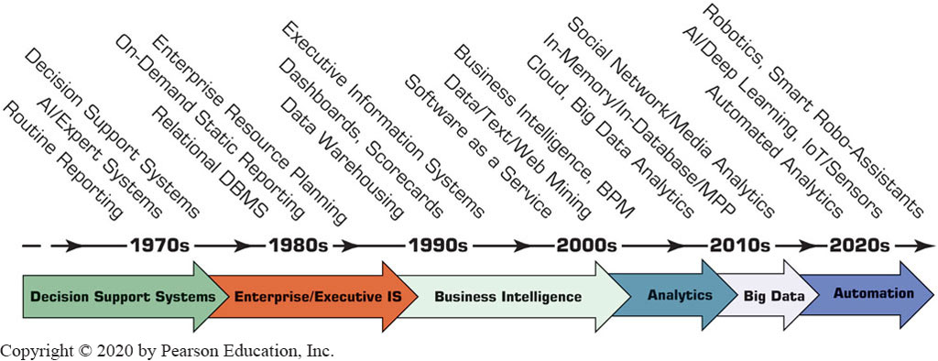
Evolution of Computerized Decision Support to Business Intelligence, Analytics, Data Science
Evolution of Decision Support, Business Intelligence, Analytics, and A I.

Slide 9
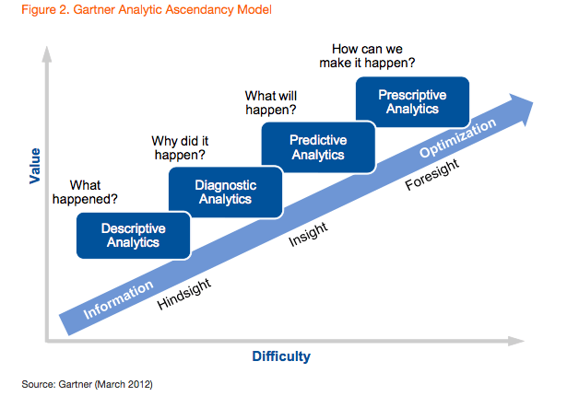
Analytics overview by Gartner: added Diagnostic Analysis

Slide 10
It’s all about making the right business decisions and how IT can facilitate or enable the decision process

Slide 11
The Machine Learning Landscape
What is Machine Learning: definitions
Machine Learning is the science (and art) of programming computers so
they can learn from data.
More general:
Machine Learning is the field of study that gives computers the ability
to learn without being explicitly programmed.
—Arthur Samuel, 1959
More engineering-oriented:
A computer program is said to learn from experience E with respect to
some task T and some performance measure P, if its performance on T,
as measured by P, improves with experience E.
—Tom Mitchell, 1997

Slide 12
Example: SPAM filter
The Machine Learning Landscape
= Machine Learning program
Given:
Examples of spam emails (flagged by users)
Examples of regular (nonspam = “ham”) emails
Learns to flag spam
Training set = example the systems uses to learn

Slide 13
Why use Machine Learning?
The Machine Learning Landscape
Traditional approach for SPAM filter
Find common words in spam emails: 4U, credit card, free, amazing, …
Flag all emails that contain (a combination of) these words as spam.
Test and repeat 1+2 until it’s good enough

Slide 14
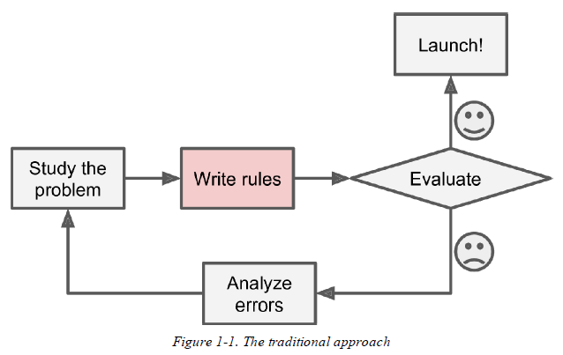
Why use Machine Learning?

Slide 15
Why use Machine Learning?
The Machine Learning Landscape
Machine learning approach for SPAM filter
automatically learns which words and phrases are good predictors of spam by detecting unusually frequent patterns of words in the spam examples compared to the ham examples
The program is much shorter, easier to maintain, and most likely more accurate.

Slide 16
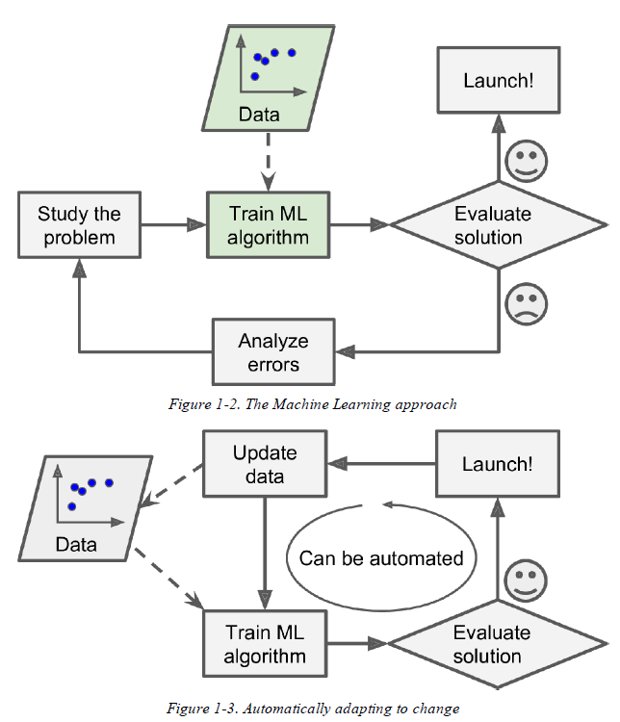
Why use machine learning?

Slide 17
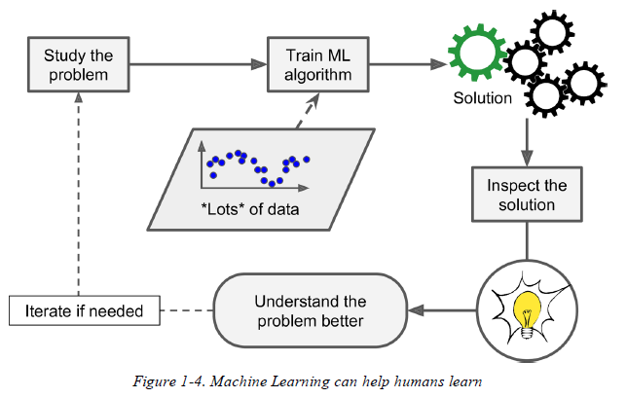
Data mining
Once a spam filter has been trained on enough spam, it can easily be inspected to reveal the list of words and combinations of words that it believes are the best predictors of spam.
Data mining = applying ML techniques to dig into large amounts of data to help discover patterns that were not immediately apparent.

Slide 18
Applications
Analyzing images of products on a production line to automatically classify them
Detecting tumors in brain scans
Automatically classifying news articles as sports, financial news, …
Automatically flagging offensive comments on discussion forums
Summarizing long documents automatically
Creating a chatbot or a personal assistant
Forecasting your company’s revenue next year, based on many performance metrics
Making your app react to voice commands
Detecting credit card fraud
Segmenting clients based on their purchases so that you can design a different marketing strategy for each segment
Representing a complex, high-dimensional dataset in a clear and insightful diagram
Recommending a product that a client may be interested in, based on past purchases
Building an intelligent bot for a game

Slide 19
Types of Machine Learning systems
Supervised/Unsupervised/Reinforcement Learning
Batch and Online Learning
Instance-Based vs. Model-Based Learning

Slide 20
Supervised/Unsupervised/Reinforcement Learning
Classified according to the extent and type of supervision they get during training.
Supervised learning
Unsupervised learning
Semi-supervised learning
Reinforcement Learning

Slide 21
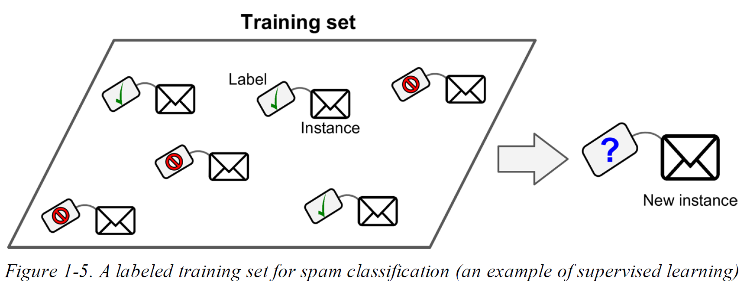
Supervised Learning: classification

Slide 22
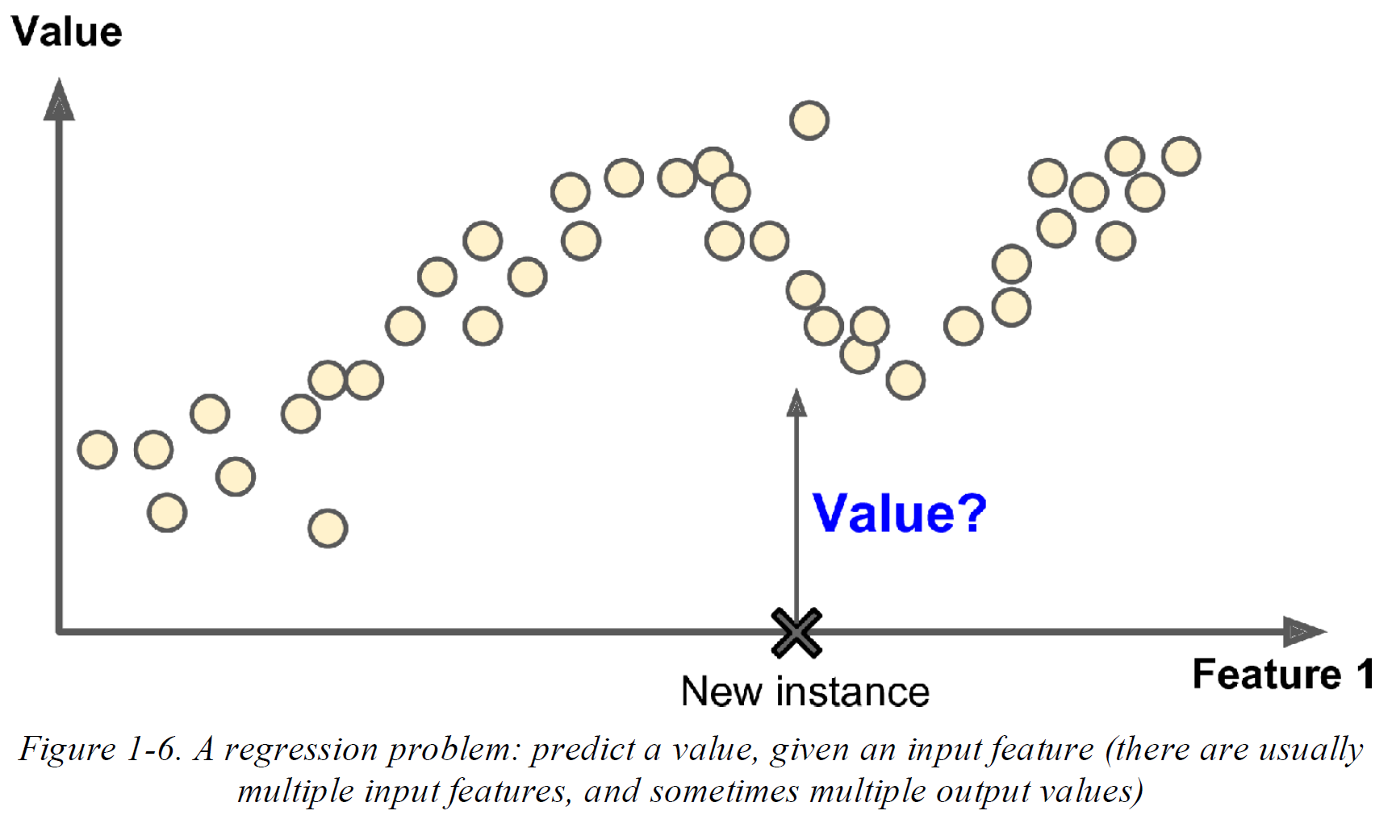
Supervised Learning: regression

Slide 23
Supervised learning: algorithms
Some of the most important supervised learning algorithms
k-Nearest Neighbors
Linear Regression
Logistic Regression
Support Vector Machines (SVMs)
Decision Trees and Random Forests
Neural networks

Slide 24
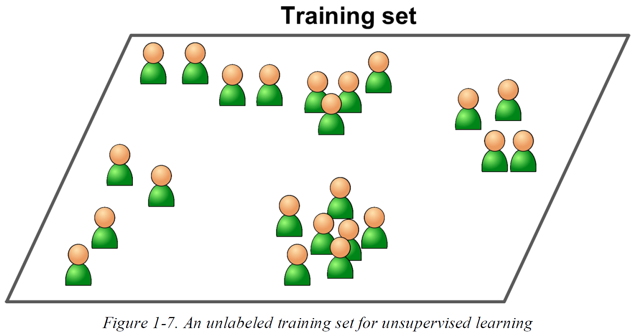
Unsupervised learning

Slide 25
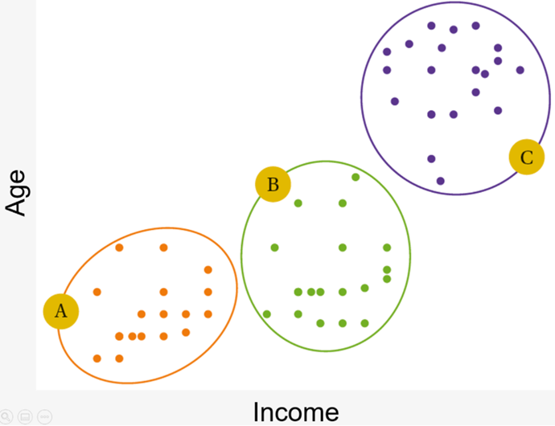
Unsupervised learning: algorithms
Clustering
K-Means
DBSCAN
Hierarchical Cluster Analysis (HCA)
Anomaly detection and novelty detection
One-class SVM
Isolation Forest
Visualization and dimensionality reduction
Principal Component Analysis (PCA)
Kernel PCA
Locally Linear Embedding (LLE)
t-Distributed Stochastic Neighbor Embedding (t-SNE)
Association rule learning (ex. Market Basket Analysis)
Apriori
Eclat
Clustering example

Slide 26
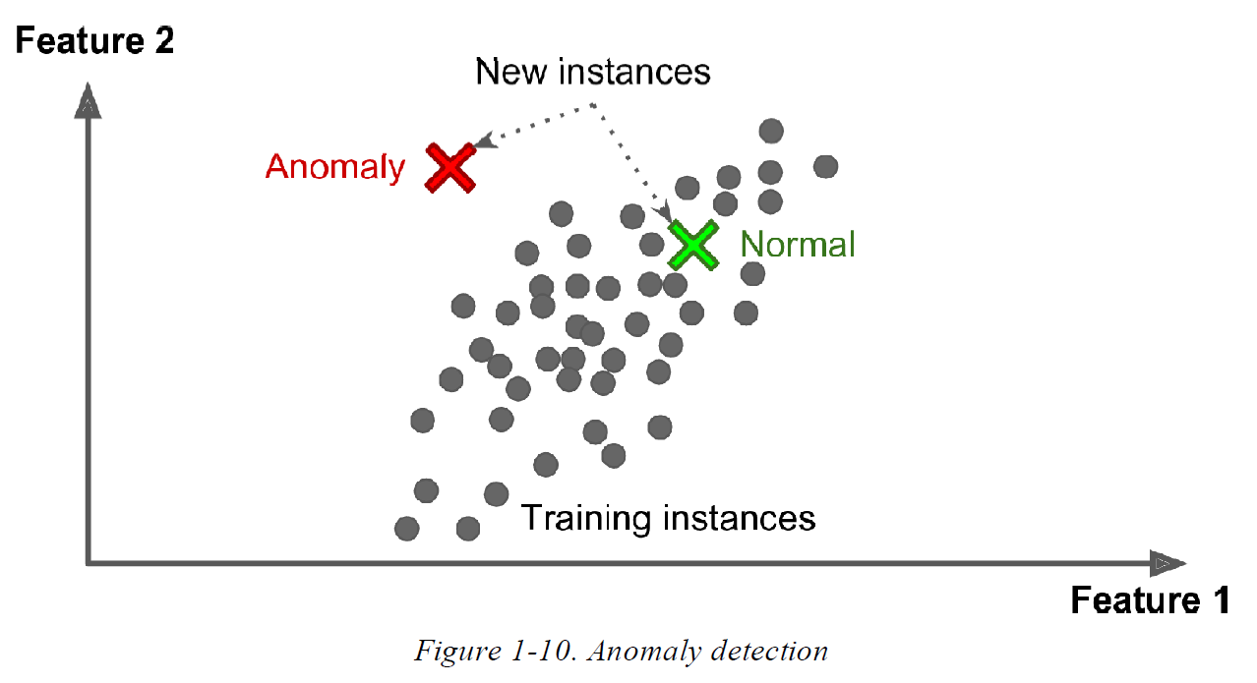
Unsupervised learning: anomaly detection

Slide 27
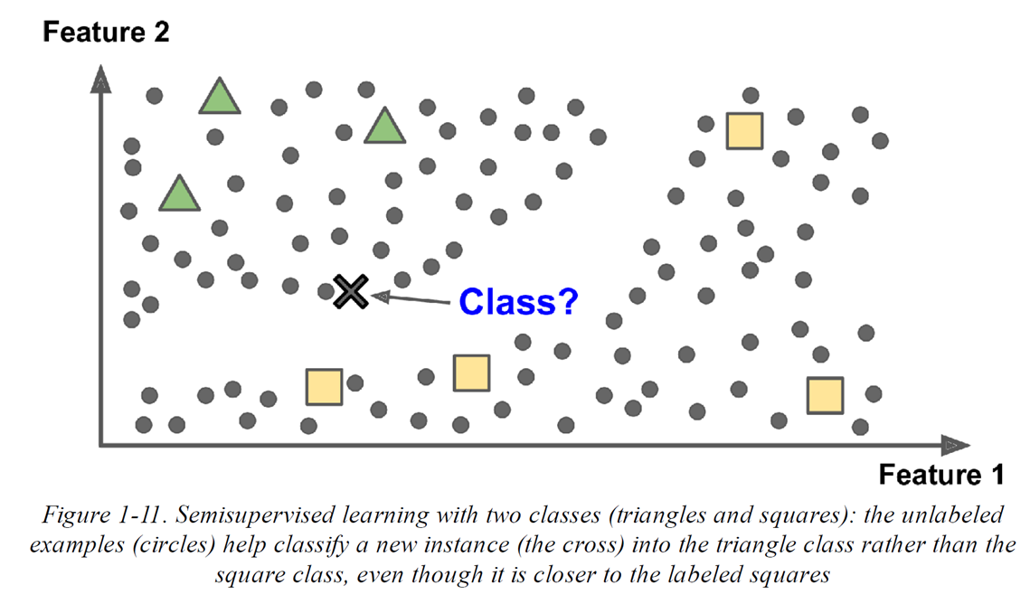
Semi-supervised learning

Slide 28
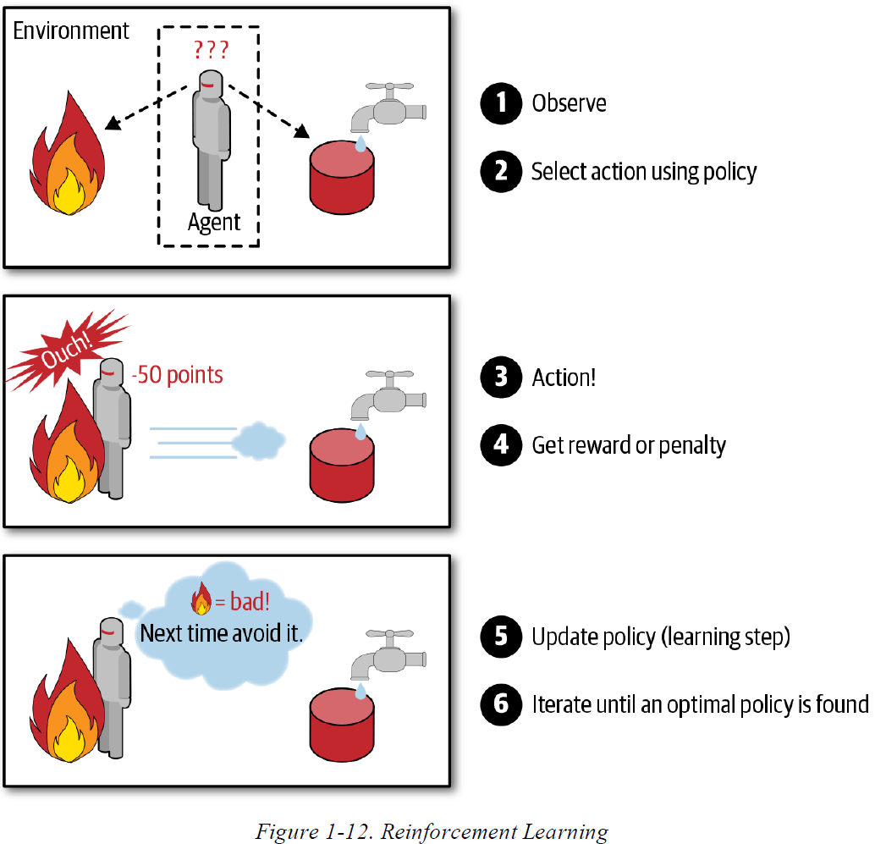
Reinforcement Learning

Slide 29

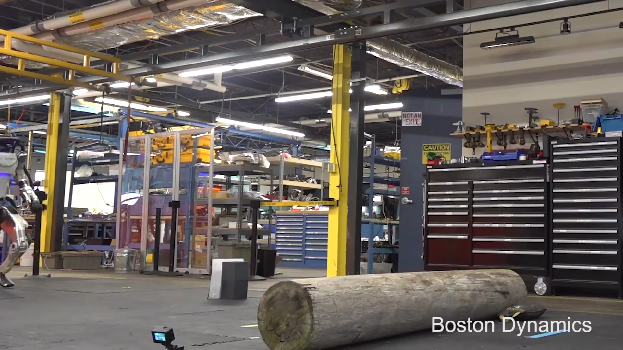
Beloningsgebaseerd leren: voorbeelden

Slide 30
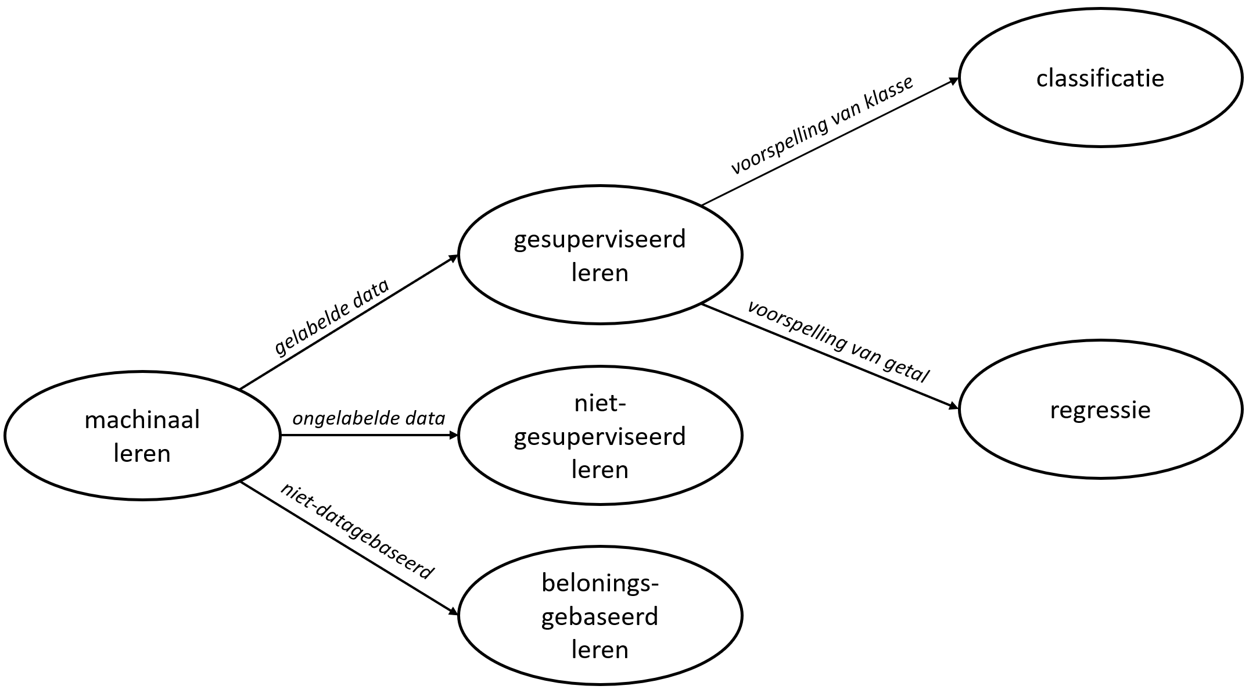
Supervised/Unsupervised/ Reinforcement Learning : samengevat

Slide 31
Batch and Online Learning
Classify Machine Learning systems based on whether the system can learn incrementally from a stream of incoming data

Slide 32
Batch learning
System is incapable of learning incrementally
It must be trained using all the available data
Takes a lot of time and computing resources → done offline (“offline learning”)
New data = retraining
This process can be automated fairly easily (see fig. 1.13)

Slide 33
Online learning
System is trained incrementally by feeding it data instances sequentially, either individually or in small groups called minibatches.
Each learning step is fast and cheap, so the system can learn about new data on the fly, as it arrives

Slide 34
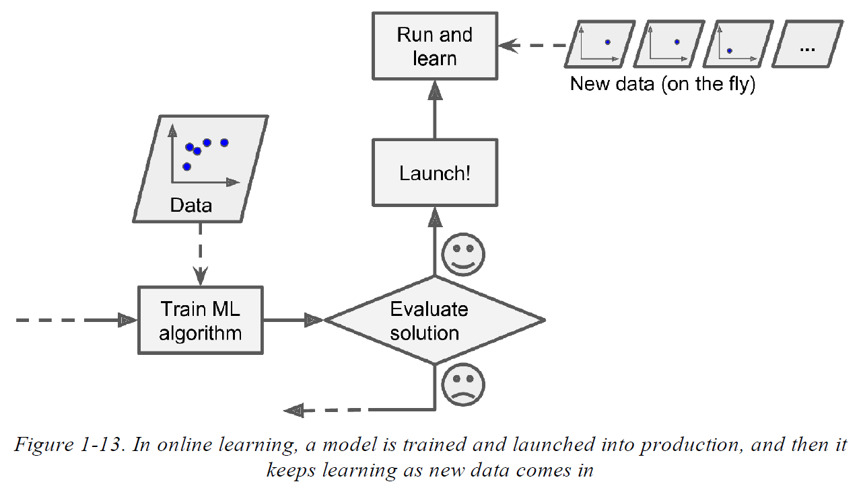
Online learning

Slide 35
Instance-Based vs. Model-Based Learning
Categorize Machine Learning systems by how they generalize.
Most Machine Learning tasks are about making predictions.
Given a number of training examples, the system needs to be able to make good predictions for examples it has never seen before. Having a good performance measure on the training data is good, but insufficient; the true goal is to perform well on new instances.
2 main approaches to generalization: instance-based learning and model-based learning.

Slide 36
Instance based learning
Classify according to measure of similarity
Example: flag an email as spam if it has many words in common with a known spam email.

Slide 37
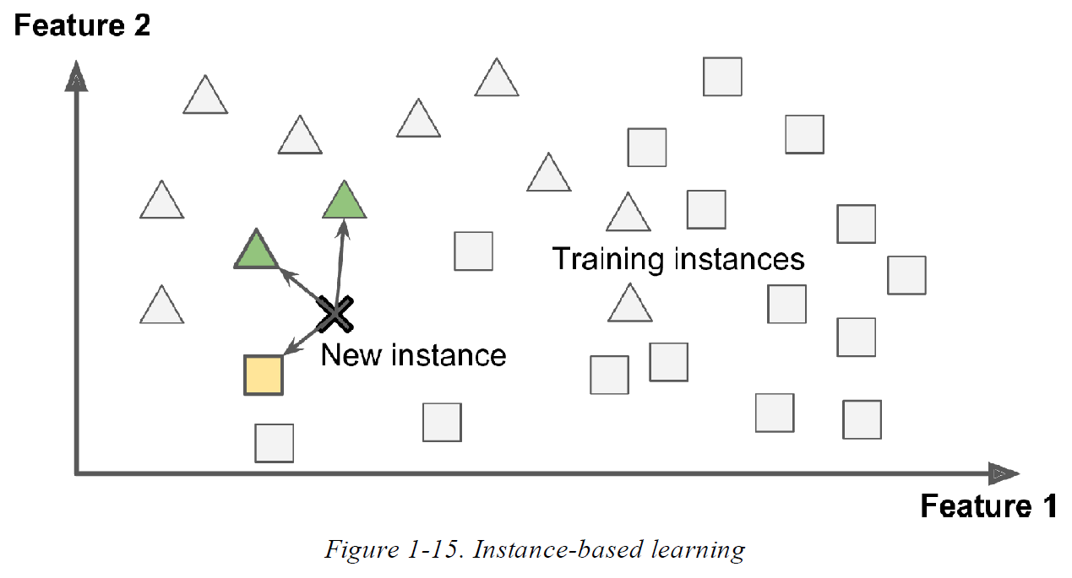
Instance based learning

Slide 38
Model-based learning
Build a model of these examples and then use that model to make predictions.

Slide 39
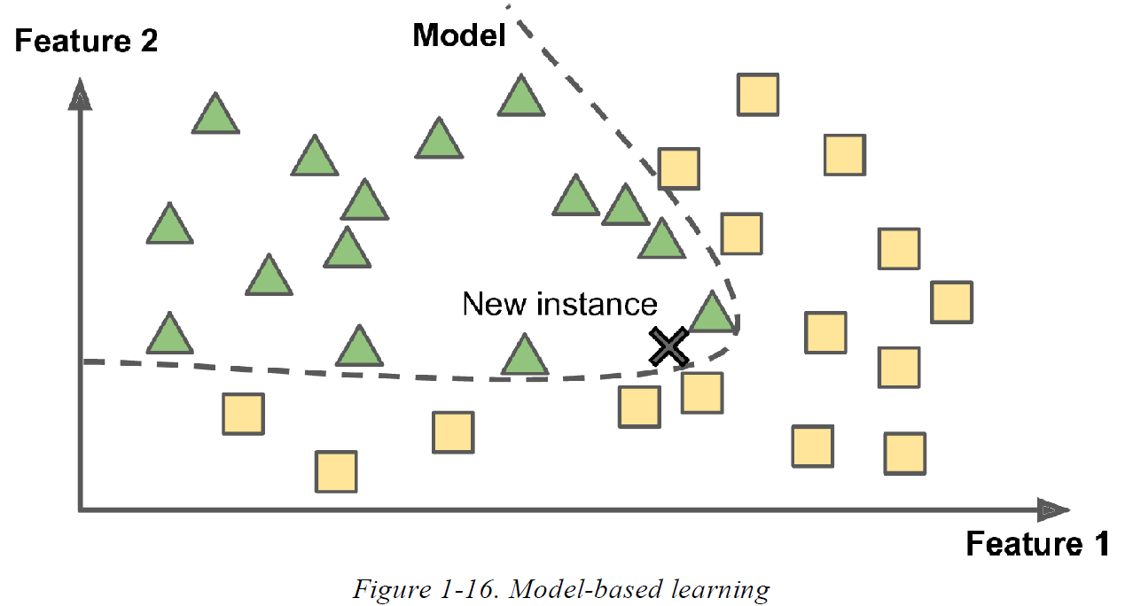
Model-based learning

Slide 40
Model Based Learning: example
See
https://github.com/HOGENT-ML/course/blob/main/111-the_machine_learning_landscape.ipynb

Slide 41
Main Challenges of Machine Learning
Insufficient Quantity of Training Data
Nonrepresentative Training Data
Irrelevant Features
Overfitting the Training Data
Underfitting the Training Data

Slide 42
Insufficient Quantity of Training Data
It takes a lot of data for most Machine Learning algorithms to work properly.
Even for very simple problems you typically need thousands of examples
For complex problems such as image or speech recognition you may need millions of examples (unless you can reuse parts of an existing model).

Slide 43
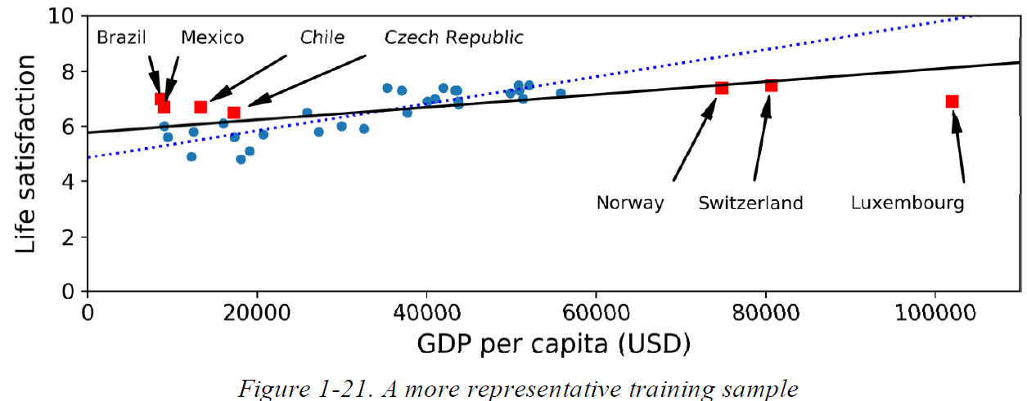
Non-representative Training Data
The set of countries we used earlier for training the linear model was not perfectly representative; a few countries were missing.

Slide 44
Non-representative Training Data
Too few data: sampling noise
Very large samples can also be nonrepresentative if the sampling method is flawed → sampling bias

Slide 45
Sampling bias: examples
Tax evasion fraud:
Who is most likely to get checked?
Based on previous cases → only detected fraud in dataset.
Perpetrator profiling (e.g. used for decision about parole)
Database of known perpetrators and their crimes → profiling
What if in database people from certain ethnic origin are overrepresented?

Slide 46
Poor-quality data
Errors (ex. wrong classifications in training set), outliers, noise.
First clean up the training data!
Some instances are clearly outliers
Some instances are missing a few features (e.g., 5% of your customers did not specify their age): decide whether you want to
ignore this attribute
ignore these instances
fill the missing values (e.g. median age)
train a model with the feature and one without

Slide 47
Irrelevant features
Garbage in/garbage out
Feature engineering
Feature selection: selecting the most useful features to train on among existing features
Feature extraction: combining existing features to produce a more useful one
Creating new features by gathering new data

Slide 48
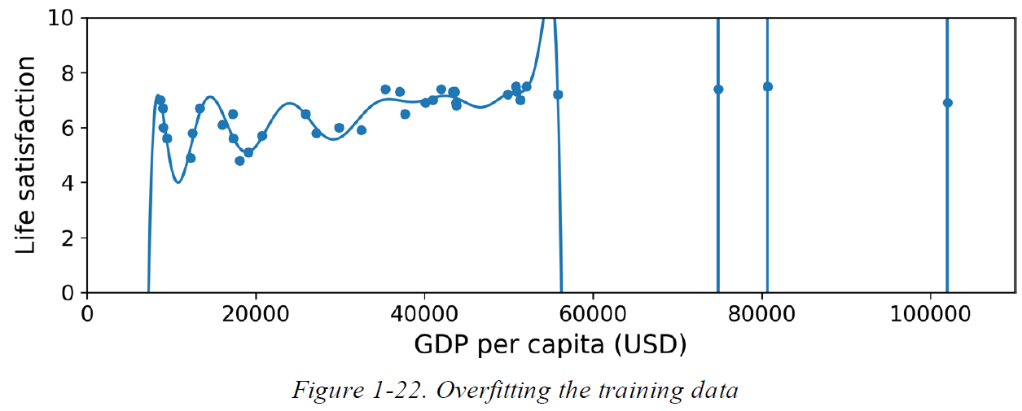
Overfitting the Training Data
Model performs well on the training data, but it does not generalize well.

Slide 49
Overfitting the Training Data
Overfitting happens when the model is too complex relative to the amount and noisiness of the training data.
Possible solutions:
Simplify the model by selecting one with fewer parameters (e.g., a linear model rather than a high-degree polynomial model), by reducing the number of attributes in the training data, or by constraining the model.
Gather more training data.
Reduce the noise in the training data (e.g., fix data errors and remove outliers).
Notes:
Start E1 vrijdag 17/2

Slide 50
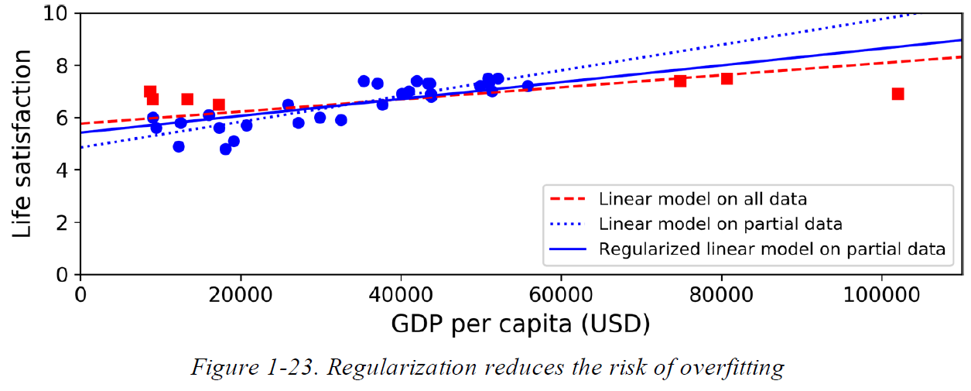
Avoid overfitting the Training Data by regularization
Linear model has two parameters, θ₀ and θ₁ → 2 degrees of freedom
Θ₁ = 0: 1 degree of freedom
Regularization: Θ₁ can vary but is forced to remain small = hyperparameter of learning algorithm

Slide 51
Underfitting the Training Data
Opposite of overfitting
Main options for fixing this problem:
Select a more powerful model, with more parameters.
Feed better features to the learning algorithm (feature engineering).
Reduce the constraints on the model (e.g., reduce the regularization hyperparameter).

Slide 52
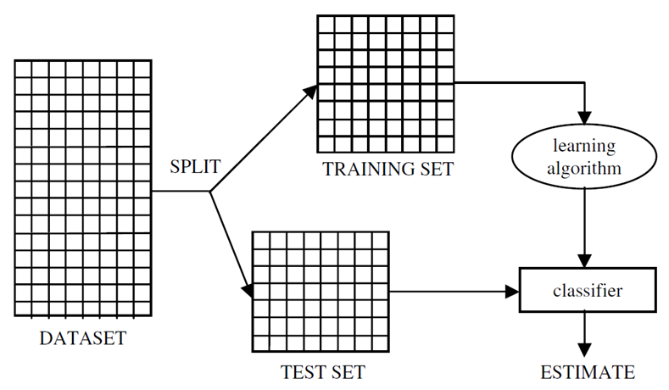
Testing and Validating
Tip:
It is common to use 80% of the data for training and hold out 20% for testing.
However, this depends on the size of the dataset: if it contains 10 million instances, then holding out 1% means your test set will contain 100,000 instances, probably
more than enough to get a good estimate of the generalization error.

Slide 53
Hyperparameter Tuning and Model Selection
Choosing between two types of model or different combinations of hyperparameters.
If using same test set each time → optimizing for that particular test set.
→ “real” error might not be correct
Solution:
use 3rd set: holdout validation (part of training set)
Train multiple models with various hyperparameters on reduced training set
Select best model according to validation set
Train this model on complete training set
Evaluate this model on test set

Slide 54
Cross-validation
If validation set is small → imprecise evaluations
If validation set is too large → remaining training set too small → not ideal to compare candidate models
Solution: cross validation
Many small validation sets
Each model is evaluated once per validation set after it is trained on the rest of the data
Average out all validations of a model
Drawback: training time is multiplied

